Slide 1
Online Course Enrollment System
Jeremy Robinson
CST499: Capstone For Computer Software
Professor Elchouemi
Date

Slide 2
Introduction
In this course I built an online course enrollment system.
The system will allow the students to register, create profiles and login into the system.
The system will improve accessibility and convenience for students, as well as improve course enrollment management for educators (Baldwin & Ching, 2019).
The system is meant to operate in a web-based environment.
This will improve accessibility for educators and students.
Notes:
Welcome everyone, today I will be presenting the online course enrollment system that I built as part of this course. This system will allow students to register, create profiles, and login to the system. It will improve accessibility and convenience for students and also improve course enrollment management for educators. The system is designed to operate in a web-based environment, improving accessibility for both educators and students. Let's move on to the next slide to learn more about the key aspects of the SRS document.

Slide 3
Key Aspects of SRS Document
The SRS document discusses the following key Aspects:
Purpose: The purpose of the system is to provide a simple and efficient way for students to find and enroll in online courses.
Features: the system allows for registration, profiles, course viewing, enrollment, waiting list and course management.
Benefits: The system will improve accessibility and convenience for both students and educators.
User Classes: Students and educators are the main users with varying levels of technical expertise.
Notes:
As seen on this slide, the SRS document covers the purpose, features, benefits, and user classes of the system. The purpose of the system is to provide a simple and efficient way for students to find and enroll in online courses. The system allows for registration, profiles, course viewing, enrollment, waiting list and course management. The system will improve accessibility and convenience for both students and educators, and the main users of the system are students and educators with varying levels of technical expertise.

Slide 4
Key Aspects of SRS Document(Continued)
Operating Environment: the system will be Web-based
The system will make use of a MySQL database for data storage.
The system frontend will be designed in HTML and CSS.
Security: All the passwords in the system will be encrypted.
Users will need to authenticate themselves so as to gain access (Shea & Bidjerano, 2018).
Non-functional requirements: The system will be reliable and user- friendly.
Notes:
Continuing from the last slide, the SRS document also covers the operating environment, security, and non-functional requirements of the system. The system will be web-based, and it will make use of a MySQL database for data storage. The system frontend will be designed in HTML and CSS. Security is also a major concern and all passwords will be encrypted. Users will be required to authenticate themselves in order to gain access. The system will be reliable and user-friendly.

Slide 5
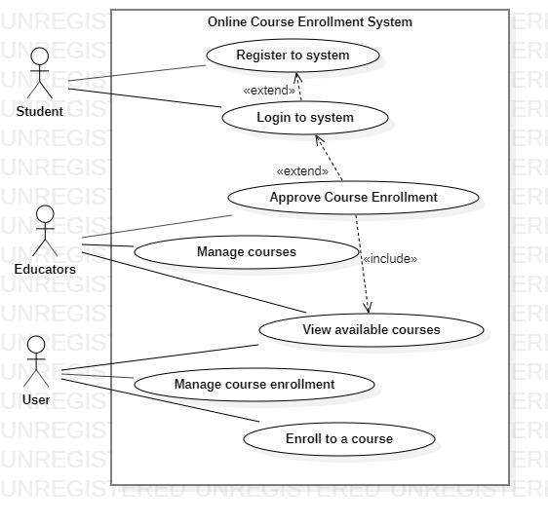
UML Design Model
The image on the side represents the use case diagram of the system to be built.
As seen in the diagram the student will be able to register to the system and as well as login.
The student will also be able to manage course enrollment and enroll to a course (Shea & Bidjerano, 2018).
The educators on the other end will be able to view and manage available courses and approve course enrollments.
Both users will have the ability to view available courses.
Notes:
As seen on this slide, the use case diagram represents the system's functionality. The student will be able to register and login, as well as manage course enrollment and enroll in a course. Educators, on the other hand, will be able to view and manage available courses and approve course enrollments. Both users will have the ability to view available courses.

Slide 6
Design of Login, Landing and Enrollment Pages
All the web pages were designed in HTML5 and CSS for styling.
The language used for backend was PHP.
To be able to run PHP I used the XAMPP Server which has both the apache and MySQL servers.
The registration page prompts the user to enter a preferred username and password (Pitt, 2021).
After registration the login page will prompt the user to enter their details and then verify if they match with those in the database.
Upon successful verification the user will be welcomed into the system on the landing page.
Notes:
The web pages were designed using HTML5 and CSS for styling. The language used for the backend was PHP, and I used the XAMPP Server to run PHP. The registration page prompts the user to enter a preferred username and password. After registration, the login page will prompt the user to enter their details and then verify them against the database. Upon successful verification, the user will be welcomed into the system on the landing page.

Slide 7
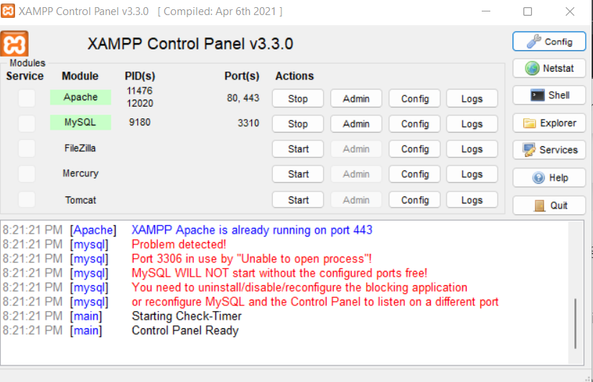
Design Of MySQL database
The image on the side shows the xampp server control panel which enables us to start the MySQL Sever.
In the PHPmyAdmin page we get to design the database for the system (Pitt, 2021).
The database has three tables namely; links, programs and login tables.
The links table stores all the links to students who have been enrolled.
Programs tables stores all programs.
The login table then stores the login information for all users.
Notes:
In this slide, we can see the XAMPP server control panel which enables us to start the MySQL server. The system uses a MySQL database for data storage. Using the PHPmyAdmin page, we were able to design the database for the system. The database has three tables, namely the links, programs, and login tables. The links table stores all the links to students who have been enrolled, the programs table stores all programs, and the login table stores the login information for all users. This database design allows us to easily manage and access student and course information.

Slide 8
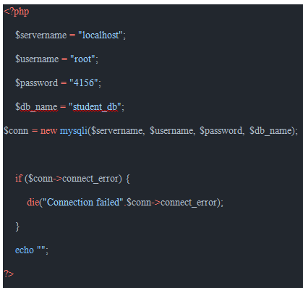
PHP Code
PHP played a major role in the development of this system.
It was the major backend programming language.
PHP was not only used for accessing and manipulate the database but also to help in the encryption of passwords (Lengstorf, Blom Hansen & Prettyman, 2022).
In this project I wrote code for several php files namely: auth_session,php, connection.php, login.php, logout.php and registration.php.
The image on the side shows how connection.php looked like.
Notes:
In this project, I used PHP as the primary backend programming language. PHP was used to access and manipulate the database and also to encrypt user passwords. I wrote code for several PHP files, including auth_session.php, connection.php, login.php, logout.php, and registration.php. The image on the screen shows how connection.php looked like.

Slide 9
Conclusion
In conclusion, the online course enrollment system is an innovative solution that provides students and educators with an easy and efficient way to find and enroll in online courses.
The system is built on a web-based environment and offers a wide range of features and functionalities, including registration, profiles, course viewing, enrollment, waiting list, and course management.
With its user-friendly interface, high uptime, and robust security features, the system is an ideal solution for any institution looking to improve accessibility and convenience for students and educators.
Notes:
In conclusion, I built an online course enrollment system that allows students to register, create profiles, and login into the system. The system improves accessibility and convenience for students and improves course enrollment management for educators. The system operates in a web-based environment and makes use of a MySQL database for data storage. The frontend of the system was designed in HTML and CSS and the backend in PHP. Security measures such as encryption of passwords and user authentication were also implemented. I believe this system will be a valuable tool for both students and educators.

Slide 10
References
Baldwin, S. J., & Ching, Y. H. (2019). Online course design. The International Review of Research in Open and Distributed Learning, 20(3).
Lengstorf, J., Blom Hansen, T., & Prettyman, S. (2022). Getting Ready to Program. In PHP 8 for Absolute Beginners (pp. 3-37). Apress, Berkeley, CA.
Pitt, C. (2021). Ways to Use PHP. In Pro PHP 8 MVC (pp. 1-12). Apress, Berkeley, CA.
Shea, P., & Bidjerano, T. (2018). Online course enrollment in community college and degree completion: The tipping point. International Review of Research in Open and Distributed Learning, 19(2).

